Slide 1
Programação Avançada
Marcos Santos, nº 94051
João Marques , nº 90865

Slide 2
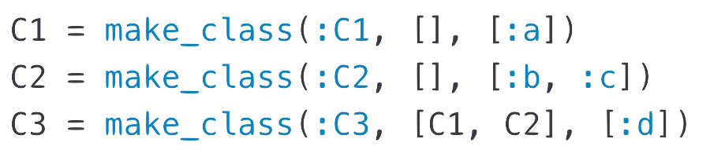
Make Class

Slide 3
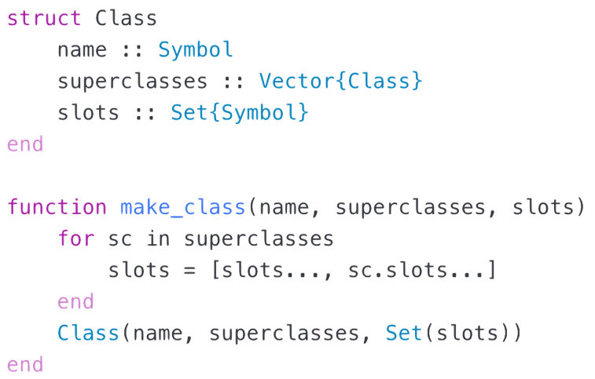
Make Class

Slide 4
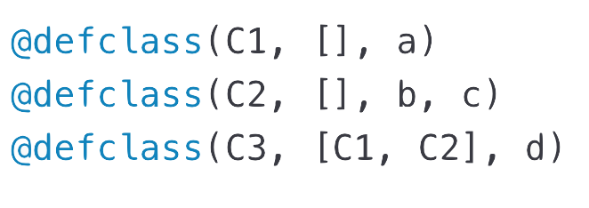
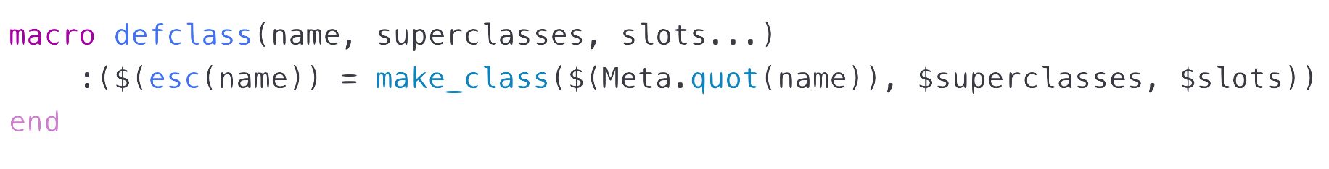
Def Class

Slide 5
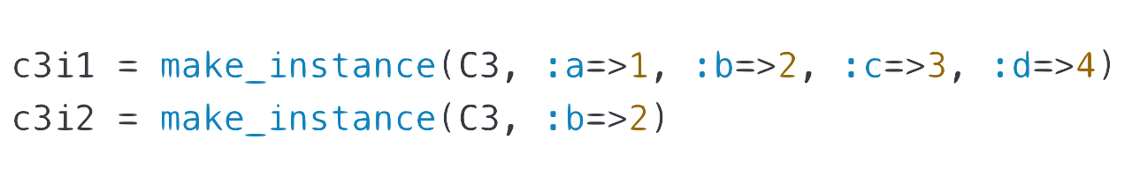
Make Instance

Slide 6
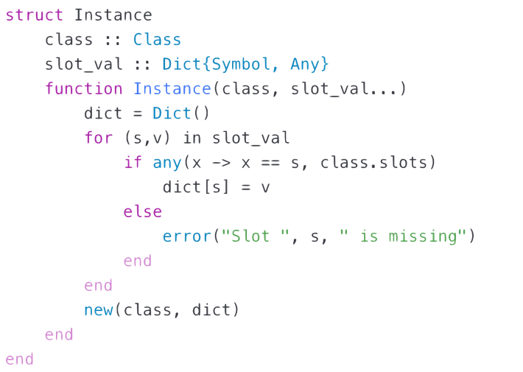
Make Instance

Slide 7
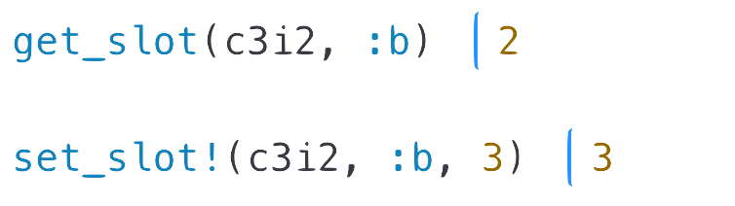
Get_Slot/Set_Slot

Slide 8
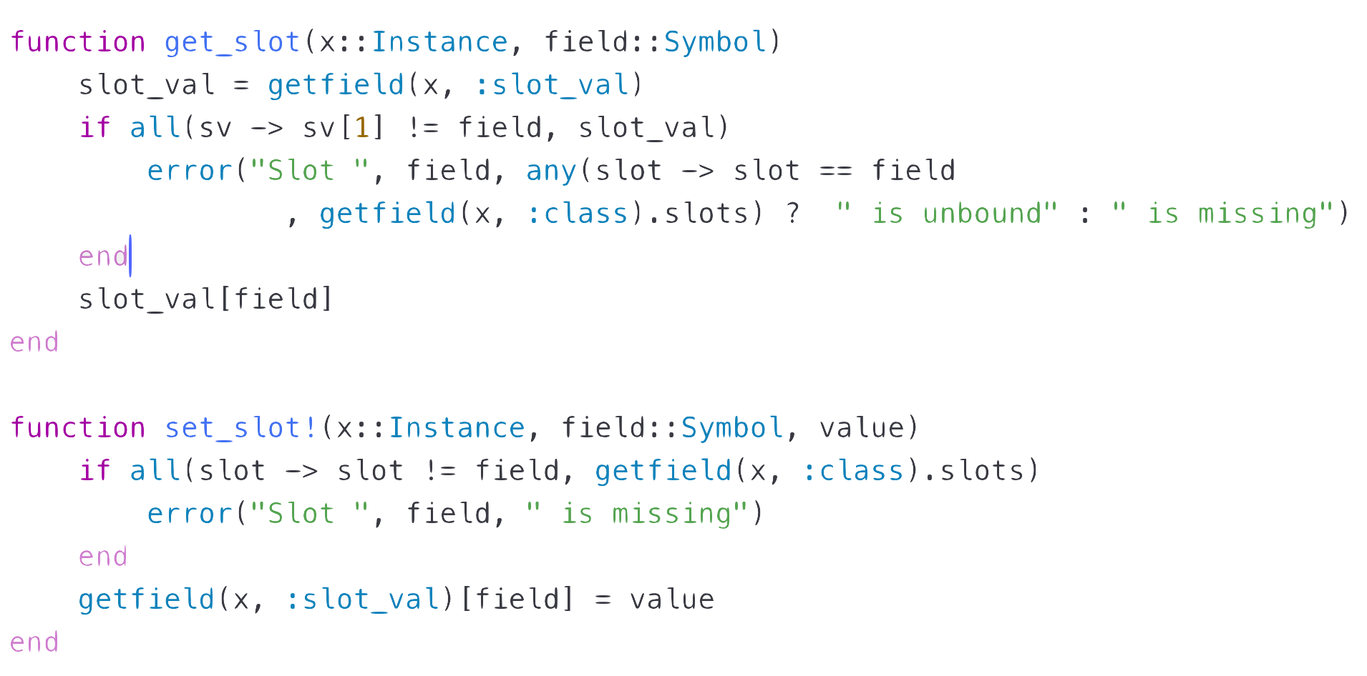
Get_Slot/Set_Slot

Slide 9
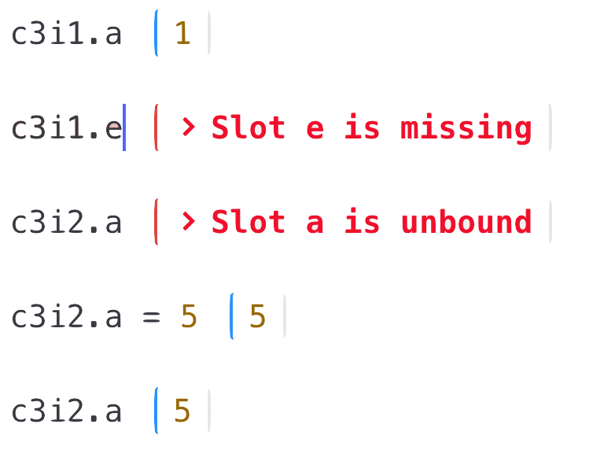
Get_Property/Set_Property

Slide 10
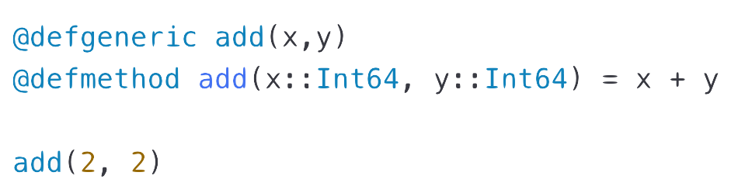
Def_Generic/Def_Method

Slide 11
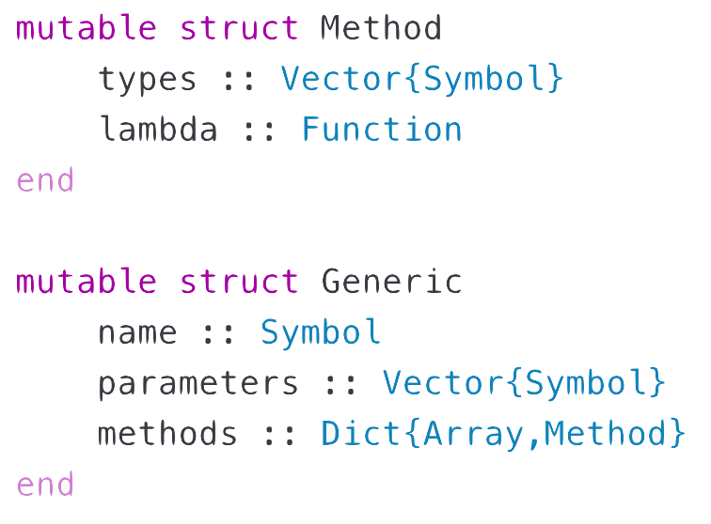
Def_Generic/Def_Method

Slide 12
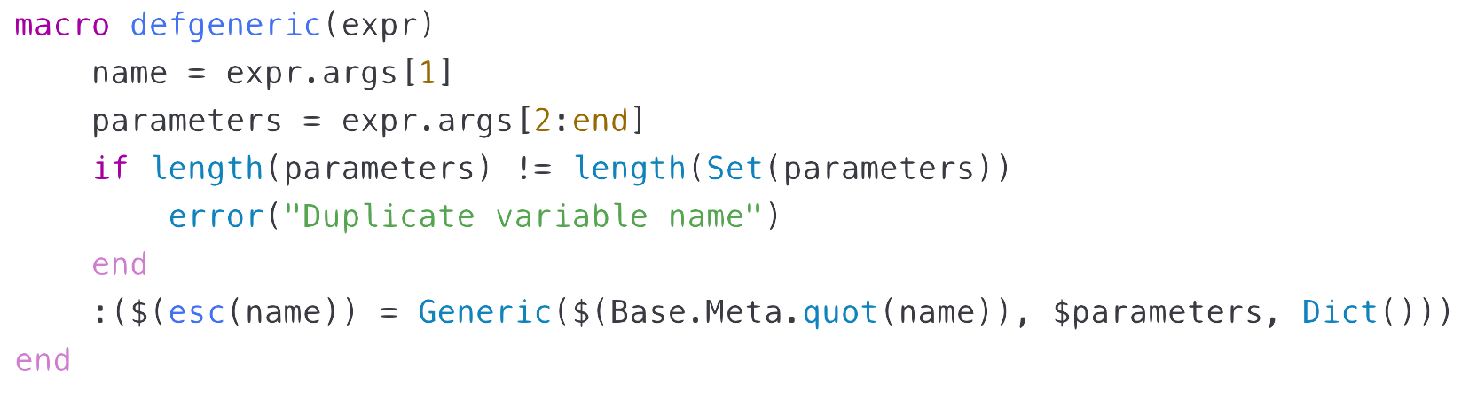
Def_Generic/Def_Method

Slide 13
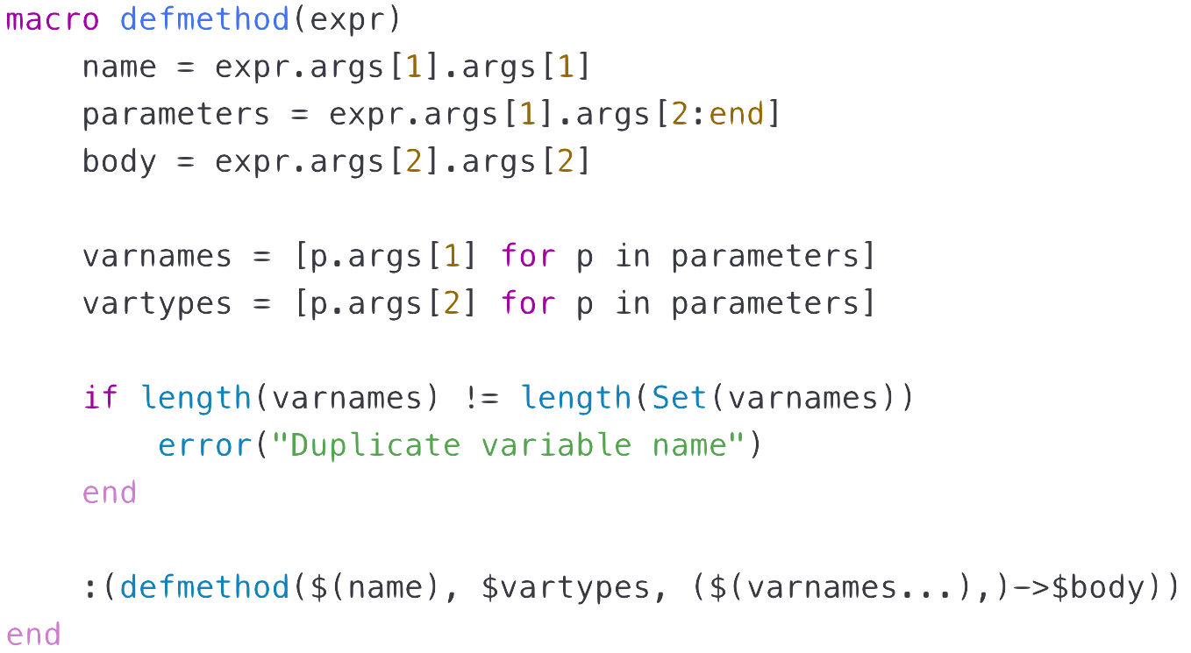
Def_Generic/Def_Method

Slide 14
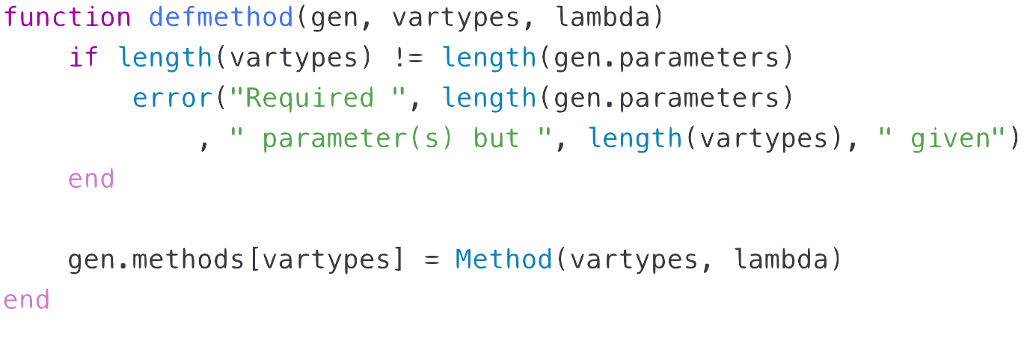
Def_Generic/Def_Method

Slide 15
Def_Generic/Def_Method

Slide 16
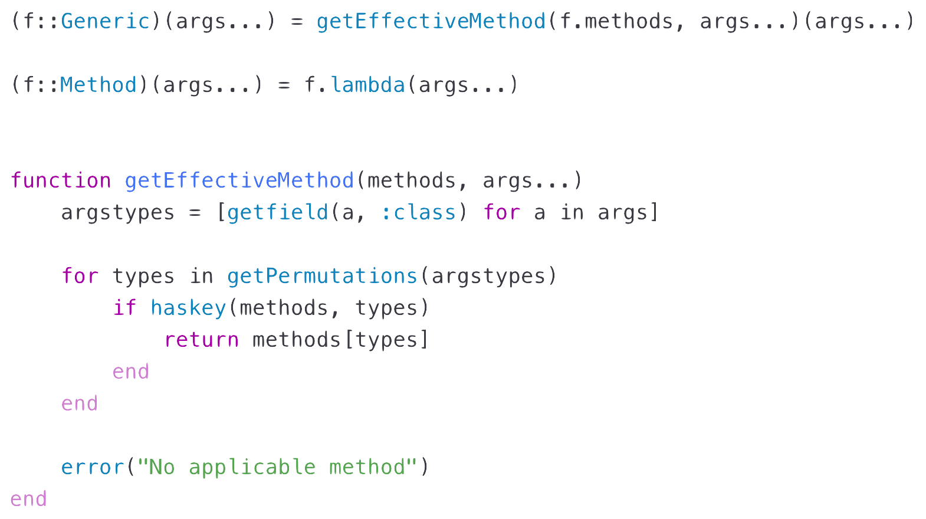
Def_Generic/Def_Method

Slide 17
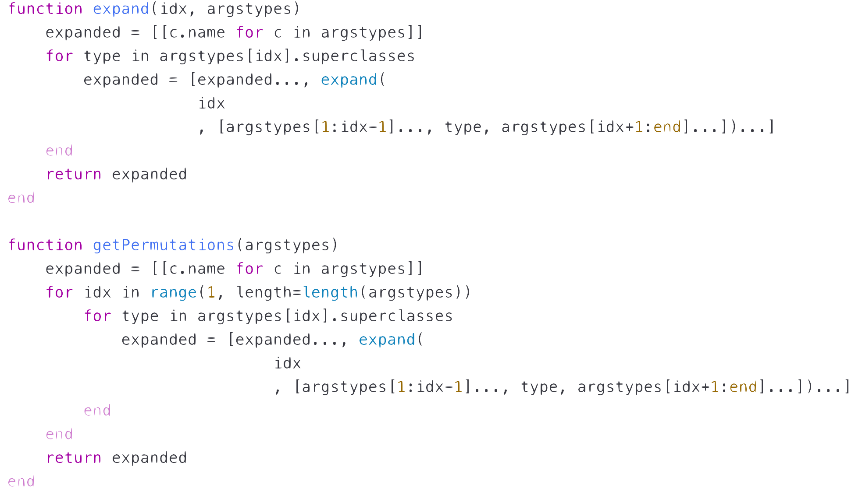
Def_Generic/Def_Method

Slide 18
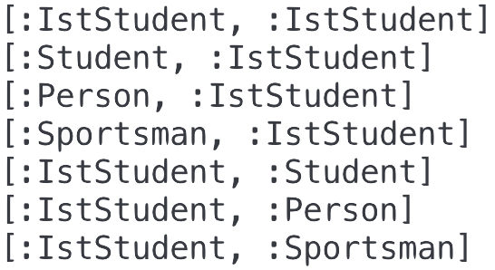
Def_Generic/Def_Method

Slide 19
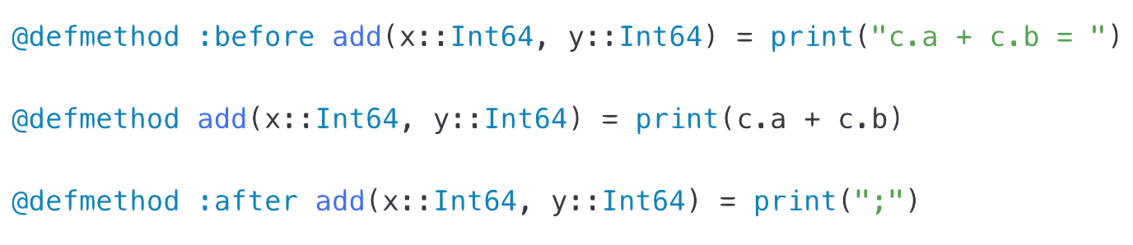
Extensions
Before/After Methods

Slide 20
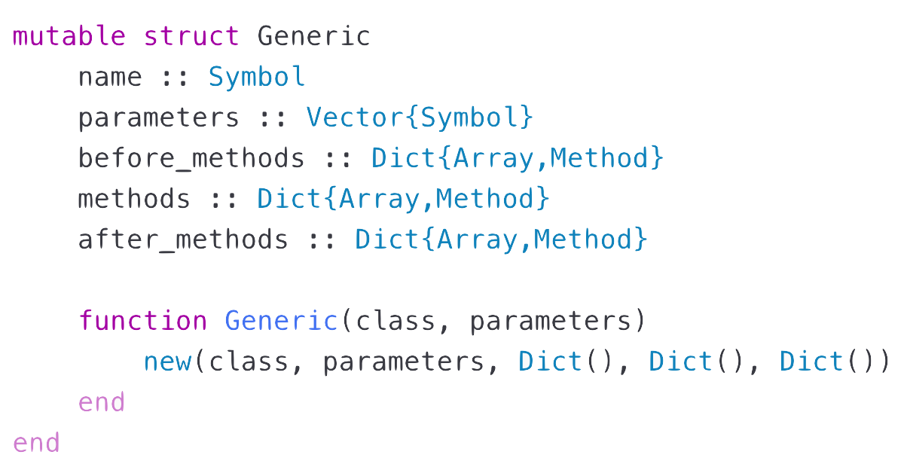
Before/After Methods

Slide 21
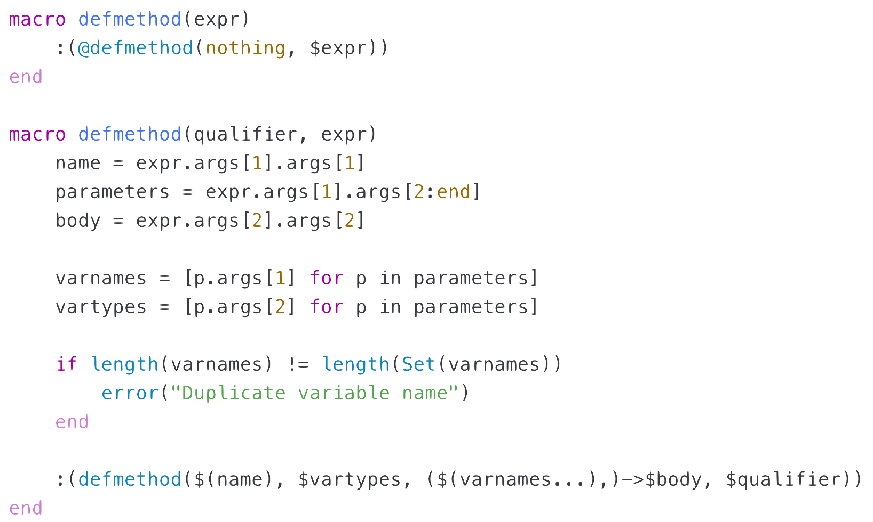
Before/After Methods

Slide 22
Before/After Methods

Slide 23
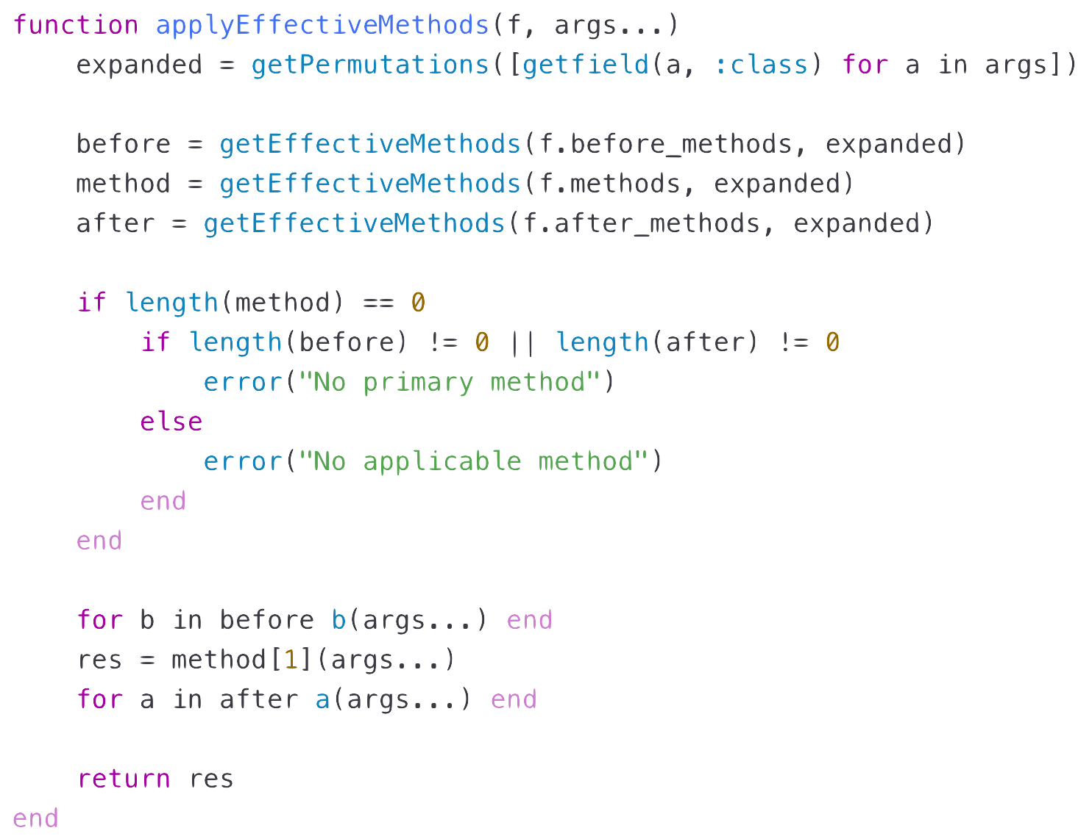
Before/After Methods

Slide 24
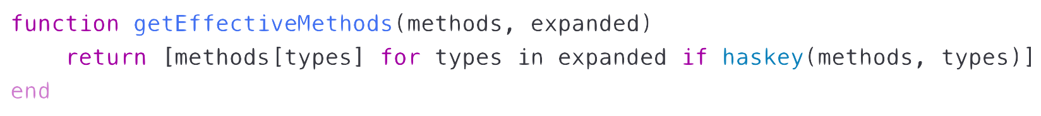
Before/After Methods

